Slide 2
Raising the Bar by
Lowering the Threshold
Kaye Heasman– Senior Investigator/Professional Practice Evaluator
Phil Straw – Lead Investigator

Slide 3
Aims
We will discuss:
Purpose of Education Council
Role of Employer and Professional Body
Requirement to report
Serious Misconduct
Vulnerable Children Act 2014
Our Code, Our Standards

Slide 4
Education Council
The purpose of the Education Council is to ensure safe and high quality leadership, teaching, and learning for children and young people in early childhood, primary, secondary, and senior secondary schooling in English medium and Māori medium settings through raising the status of the profession.
Section 377 of the Education Act 1989

Slide 5
Employer role and Professional Body role
Employment
Teacher and school
Professional
Teacher and Education Council

Slide 6
Requirement to report
Sections 392 to 395 of the Education Act 1989
Employers must immediately report to the Education Council:
All dismissals
If, within the 12 months before a resignation or expiry of a fixed term position, the employer has advised the teacher that it was dissatisfied with, or intended to investigate, any aspect of the teacher’s conduct or competence
If the employer has reason to believe the teacher has engaged in serious misconduct

Slide 7
Serious Misconduct
Definition of Serious Misconduct
Section 378 of the Education Act 1989:
Adversely affects, or is likely to adversely affect, the well being or learning of one or more children; or
Reflects adversely on the teachers fitness to be a teacher; or
May bring the teaching profession into disrepute
AND
Must be of a character and severity that meets the Education Council’s criteria for reporting serious misconduct (that is, Rule 9)

Slide 8
Rule 9 – Criteria for Reporting Serious Misconduct (Page 1)
Physical, sexual or psychological abuse of a child
Inappropriate relationship with a student or anyone under 16
Neglect or ill treatment of any child or young person
Neglect or ill treatment of any animal
Theft or fraud
Manufacture, cultivation, supply, dealing or use of controlled drugs
Pornography on school premises or engaged on school business
Pornography involving children or young persons

Slide 9
Rule 9 – Criteria for Reporting Serious Misconduct (Page 2)
Breaching school standards concerning alcohol
Any act or omission that could be the subject of a prosecution for an offence punishable by 3 months’ imprisonment
Any act or omission that brings, or is likely to bring, discredit to the profession

Slide 10
Vulnerable Children Act 2014 (VCA)
Among other things, the VCA introduced children’s workers safety checking to reduce the risk of harm to children
A school or ECE cannot employ or engage a person who has a conviction for a specified offence unless she or he hold an exemption (s28)
This is reflected in the Education Act – a person cannot be registered as a teacher if she or he has been convicted of a specified offence and does not hold an exemption
There is a list of specified offences in the VCA which includes assault on a child (s194 Crimes Act 1961)

Slide 11
What if the teacher was not convicted of an offence?
Many teachers are never prosecuted for behaviour towards students that are technically an assault on a child
Since 1 July 2015, any matter that may possibly constitute serious misconduct must be referred to the Disciplinary Tribunal (s401)
Cases that were previously being dealt with by the Complaints Assessment Committee (CAC) are being referred to the Disciplinary Tribunal – including cases where teachers have used physical force/corporal punishment on a student
Hearings are public unlike the CAC process
Raises public awareness of the high standards that teachers are held to

Slide 12
Penalty and Considerations
Purposes of penalty are the protection of the public through the provision of a safe learning environment for students, and the maintenance of both professional standards and the public’s confidence in the profession. (NZTDT 2016/60)
Section 139A of the Education Act 1989 – Banned use of corporal punishment
Vulnerable Children Act 2014 – List of specified offences
Section 377 of the Education Act 1989 – Education Council is to ensure students are provided with a safe learning environment

Slide 13
Code of Professional Responsibility and Standards for the Teaching Profession
The Code of Professional Responsibility and Standards for the Teaching Profession has been crafted by teachers, leaders and teaching experts to articulate the expectations and aspirations of our profession.
The Code sets out the high standards for ethical behaviour that are expected of every teacher; the Standards describe the expectations of effective teaching practice.
Together they set out what it is, and what it means, to be a teacher in Aotearoa New Zealand. The Code and Standards apply to every certificated teacher, regardless of role or teaching environment. The Code also applies to those who have been granted a Limited Authority to Teach.

Slide 14
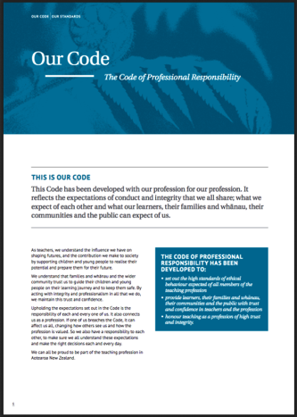
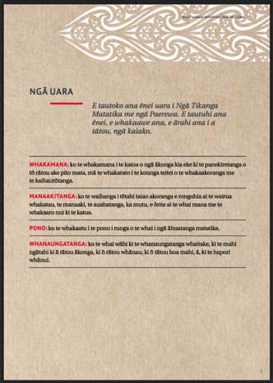
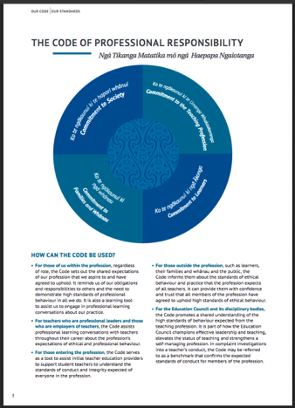
Code and Standards

Slide 15
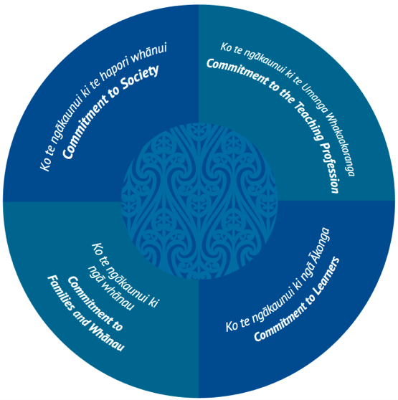
Code of Professional Responsibility

Slide 16
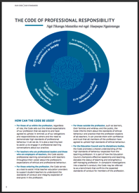
Code and Standards: How they can be used …
For those within the profession – shared expectations,
obligations and responsibilities. Learning tool to supports
appraisal and professional development.
For professional leaders and employers of teachers –
supports professional learning conversations, provides
guidance on ethical and professional conduct.
For those entering the profession – assists initial teacher education providers as they support student teachers to enter the profession with clear expectations of what is required.
For those outside the profession – provides learners, their families/whānau, and the public with confidence about the high level of teaching and ethical excellence they can expect from the teaching profession.
For the Education Council and it’s disciplinary bodies – a shared benchmark for the expected standards of conduct and competence that can be used to review behaviour and practice.

Slide 17
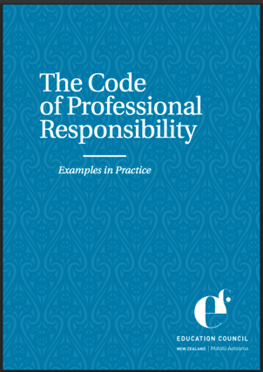
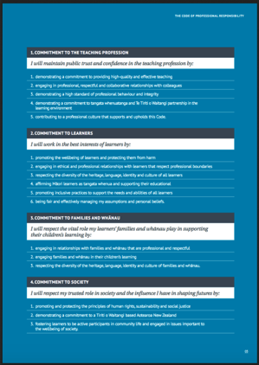
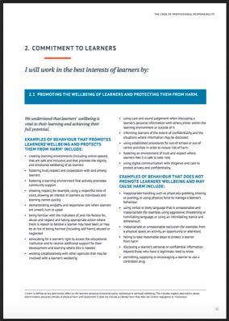
Examples of the Code in Practice

Slide 18
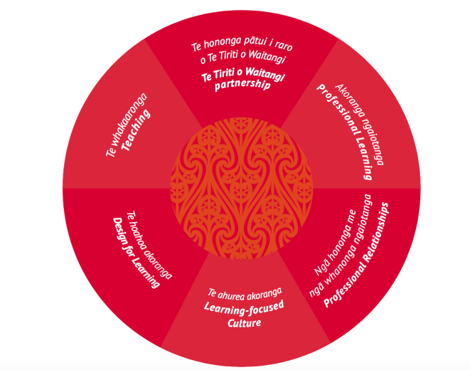
Standards for the Teaching Profession

Slide 19
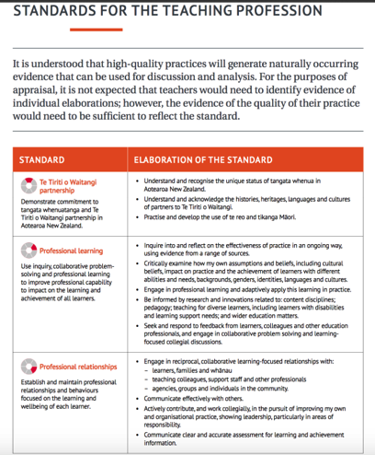
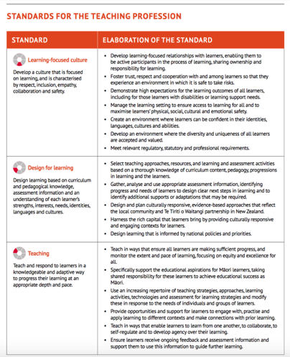
Standards for the Teaching Profession

Slide 20
Key Things You Need To Know
Code of Professional Responsibility came into effect for all teachers (including principals) from 30 June 2017
All schools are expected to be using the new Standards for the Teaching Profession in their appraisal processes by January 2017.
(Note: school boards need to consider this in the appraisal processes they have in place with their principals)
A range of supporting resources are being developed and will be available through the Education Council shortly.
The new Code and Standards are key tools for your school to use to support professional learning conversations and remind all staff of the shared expectations of the teaching profession.
Rather than punitive items, they are intended as aids to reinforce best practice.

Slide 21
Questions

Slide 23
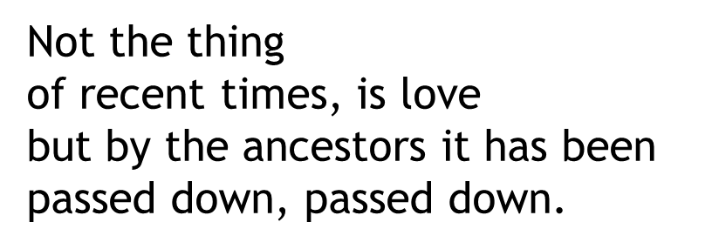
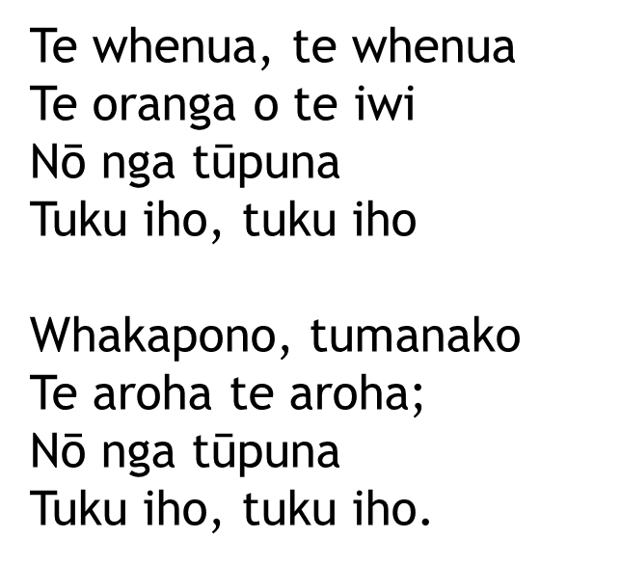
Ehara i te mea¹ Nō nāianei te aroha Nō nga tūpuna Tuku iho, tuku iho
Te whenua, te whenua Te oranga o te iwi Nō nga tūpuna Tuku iho, tuku iho
Whakapono, tumanako Te aroha te aroha; Nō nga tūpuna Tuku iho, tuku iho.

